Slide 1

Slides developed by Mine Çetinkaya-Rundel of OpenIntro
Translated from LaTeX to Google Slides by Curry W. Hilton of OpenIntro.
The slides may be copied, edited, and/or shared via the CC BY-SA license
To make a copy of these slides, go to File > Download as > [option], as shown below. Or if you are logged into a Google account, you can choose Make a copy... to create your own version in Google Drive.

Slide 2
Chi-Square test of GOF

Slide 3
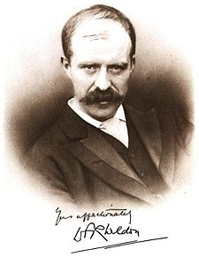
Weldon's dice
Walter Frank Raphael Weldon (1860 - 1906), was an English evolutionary biologist and a founder of biometry. He was the joint founding editor of Biometrika, with Francis Galton and Karl Pearson.
In 1894, he rolled 12 dice 26,306 times, and recorded the number of 5s or 6s (which he considered to be a success).
It was observed that 5s or 6s occurred more often than expected, and Pearson hypothesized that this was probably due to the construction of the dice. Most inexpensive dice have hollowed-out pips, and since opposite sides add to 7, the face with 6 pips is lighter than its opposing face, which has only 1 pip.

Slide 4
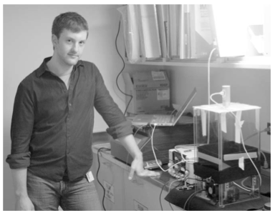
Labby's dice
In 2009, Zacariah Labby (U of Chicago), repeated Weldon's experiment using a homemade dice-throwing, pip counting machine.
www.youtube.com/watch?v=95EErdouO2w
The rolling-imaging process took about 20 seconds per roll.
Each day there were ~150 images to process manually.
At this rate Weldon's experiment was repeated in a little more than six full days.
Recommended reading: galton.uchicago.edu/about/docs/labby09dice.pdf

Slide 5
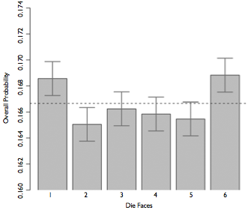
Labby's dice (cont.)
Labby did not actually observe the same phenomenon that Weldon observed (higher frequency of 5s and 6s).
Automation allowed Labby to collect more data than Weldon did in 1894, instead of recording "successes" and "failures", Labby recorded the individual number of pips on each die.

Slide 6
Expected counts
Labby rolled 12 dice 26,306 times. If each side is equally likely to come up, how many 1s, 2s, ..., 6s would he expect to have observed?
1/6
12/6
26,306 / 6
12 x 26,306 / 6

Slide 7
Expected counts
Labby rolled 12 dice 26,306 times. If each side is equally likely to come up, how many 1s, 2s, ..., 6s would he expect to have observed?
1/6
12 / 6
26,306 / 6
12 x 26,306 / 6 = 52,612

Slide 8
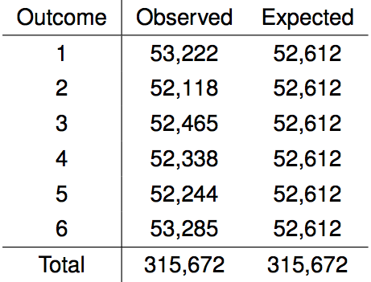
Summarizing Labby's results
The table below shows the observed and expected counts from Labby's experiment.

Slide 9
Summarizing Labby's results
The table below shows the observed and expected counts from Labby's experiment.
Why are the expected counts the same for all outcomes but the observed counts are different? At a first glance, does there appear to be an inconsistency between the observed and expected counts?

Slide 10
Setting the hypotheses
Do these data provide convincing evidence of an inconsistency between the observed and expected counts?

Slide 11
Setting the hypotheses
Do these data provide convincing evidence of an inconsistency between the observed and expected counts?
H₀: There is no inconsistency between the observed and the expected counts. The observed counts follow the same distribution as the expected counts.

Slide 12
Setting the hypotheses
Do these data provide convincing evidence of an inconsistency between the observed and expected counts?
H₀: There is no inconsistency between the observed and the expected counts. The observed counts follow the same distribution as the expected counts.
H_{A}: There is an inconsistency between the observed and the expected counts. The observed counts do not follow the same distribution as the expected counts. There is a bias in which side comes up on the roll of a die.

Slide 13
Evaluating the hypotheses
To evaluate these hypotheses, we quantify how different the observed counts are from the expected counts.

Slide 14
Evaluating the hypotheses
To evaluate these hypotheses, we quantify how different the observed counts are from the expected counts.
Large deviations from what would be expected based on sampling variation (chance) alone provide strong evidence for the alternative hypothesis.

Slide 15
Evaluating the hypotheses
To evaluate these hypotheses, we quantify how different the observed counts are from the expected counts.
Large deviations from what would be expected based on sampling variation (chance) alone provide strong evidence for the alternative hypothesis.
This is called a goodness of fit test since we're evaluating how well the observed data fit the expected distribution.

Slide 16

Anatomy of a test statistic
The general form of a test statistic is

Slide 17
Anatomy of a test statistic
The general form of a test statistic is
This construction is based on
identifying the difference between a point estimate and an expected value if the null hypothesis was true, and
standardizing that difference using the standard error of the point estimate.

Slide 18
Anatomy of a test statistic
The general form of a test statistic is
This construction is based on
identifying the difference between a point estimate and an expected value if the null hypothesis was true, and
standardizing that difference using the standard error of the point estimate.
These two ideas will help in the construction of an appropriate test statistic for count data.

Slide 19
Chi-square statistic
When dealing with counts and investigating how far the observed counts are from the expected counts, we use a new test statistic called the chi-square (χ²) statistic.

Slide 20
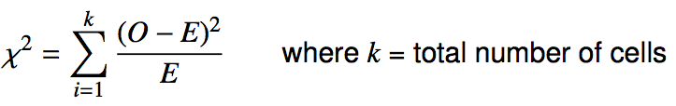
Chi-square statistic
When dealing with counts and investigating how far the observed counts are from the expected counts, we use a new test statistic called the chi-square (χ²) statistic.
χ² statistic

Slide 21
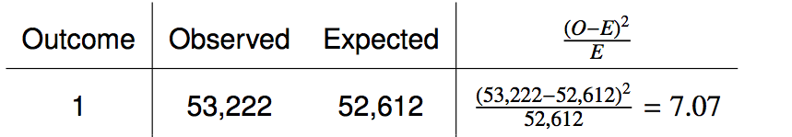
Calculating the chi-square statistic

Slide 22
Calculating the chi-square statistic

Slide 23
Calculating the chi-square statistic

Slide 24

Calculating the chi-square statistic

Slide 25
Calculating the chi-square statistic

Slide 26
Calculating the chi-square statistic

Slide 27

Calculating the chi-square statistic

Slide 28
Why square?
Squaring the difference between the observed and the expected outcome does two things:

Slide 29
Why square?
Squaring the difference between the observed and the expected outcome does two things:
Any standardized difference that is squared will now be positive.

Slide 30
Why square?
Squaring the difference between the observed and the expected outcome does two things:
Any standardized difference that is squared will now be positive.
Differences that already looked unusual will become much larger after being squared.

Slide 31
Why square?
Squaring the difference between the observed and the expected outcome does two things:
Any standardized difference that is squared will now be positive.
Differences that already looked unusual will become much larger after being squared.
When have we seen this before?

Slide 32
The chi-square distribution
In order to determine if the χ² statistic we calculated is considered unusually high or not we need to first describe its distribution.

Slide 33
The chi-square distribution
In order to determine if the χ² statistic we calculated is considered unusually high or not we need to first describe its distribution.
The chi-square distribution has just one parameter called degrees of freedom (df), which influences the shape, center, and spread of the distribution.

Slide 34
The chi-square distribution
In order to determine if the χ² statistic we calculated is considered unusually high or not we need to first describe its distribution.
The chi-square distribution has just one parameter called degrees of freedom (df), which influences the shape, center, and spread of the distribution.
Remember
So far we've seen three other continuous distributions:
normal distribution: unimodal and symmetric with two parameters: mean and standard deviation
T distribution: unimodal and symmetric with one parameter: degrees of freedom
F distribution: unimodal and right skewed with two parameters: degrees of freedom or numerator (between group variance) and denominator (within group variance)

Slide 35
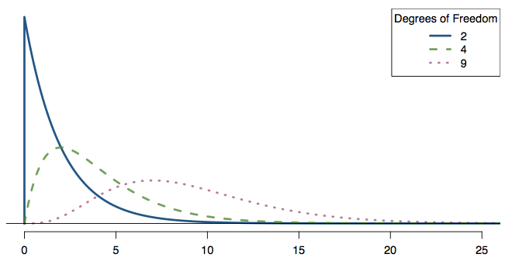
Practice
Which of the following is false?
As the df increases,
the center of the χ² distribution increases as well
the variability of the χ² distribution increases as well
the shape of the χ² distribution becomes more skewed (less like a normal)

Slide 36
Practice
Which of the following is false?
As the df increases,
the center of the χ² distribution increases as well
the variability of the χ² distribution increases as well
the shape of the χ² distribution becomes more skewed (less like a normal)

Slide 37
Finding areas under the chi-square curve
p-value = tail area under the chi-square distribution (as usual)

Slide 38
Finding areas under the chi-square curve
p-value = tail area under the chi-square distribution (as usual)
For this we can use technology, or a chi-square probability table.

Slide 39
Finding areas under the chi-square curve
Estimate the shaded area under the chi-square curve with df = 6.

Slide 40
Finding areas under the chi-square curve
Estimate the shaded area under the chi-square curve with df = 6.
> pchisq(q = 10, df = 6, lower.tail = FALSE)
[1] 0.124652

Slide 41
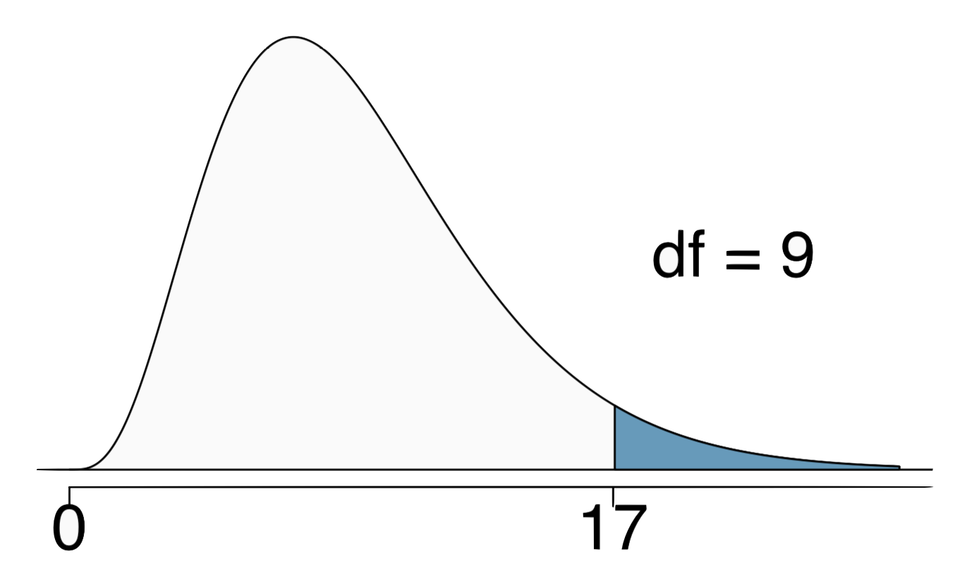
Finding areas under the chi-square curve
Estimate the shaded area above a cutoff value of 17 for the chi-square curve with df = 9.
(a) 0.05
(b) 0.02
(c) between 0.02 and 0.05
(d) between 0.05 and 0.1
(e) between 0.01 and 0.02

Slide 42
Finding areas under the chi-square curve
Estimate the shaded area above a cutoff value of 17 for the chi-square curve with df = 9.
(a) 0.05
(b) 0.02
(c) between 0.02 and 0.05
(d) between 0.05 and 0.1
(e) between 0.01 and 0.02
> pchisq(q = 17, df = 9, lower.tail = FALSE)
[1] 0.04871598

Slide 43
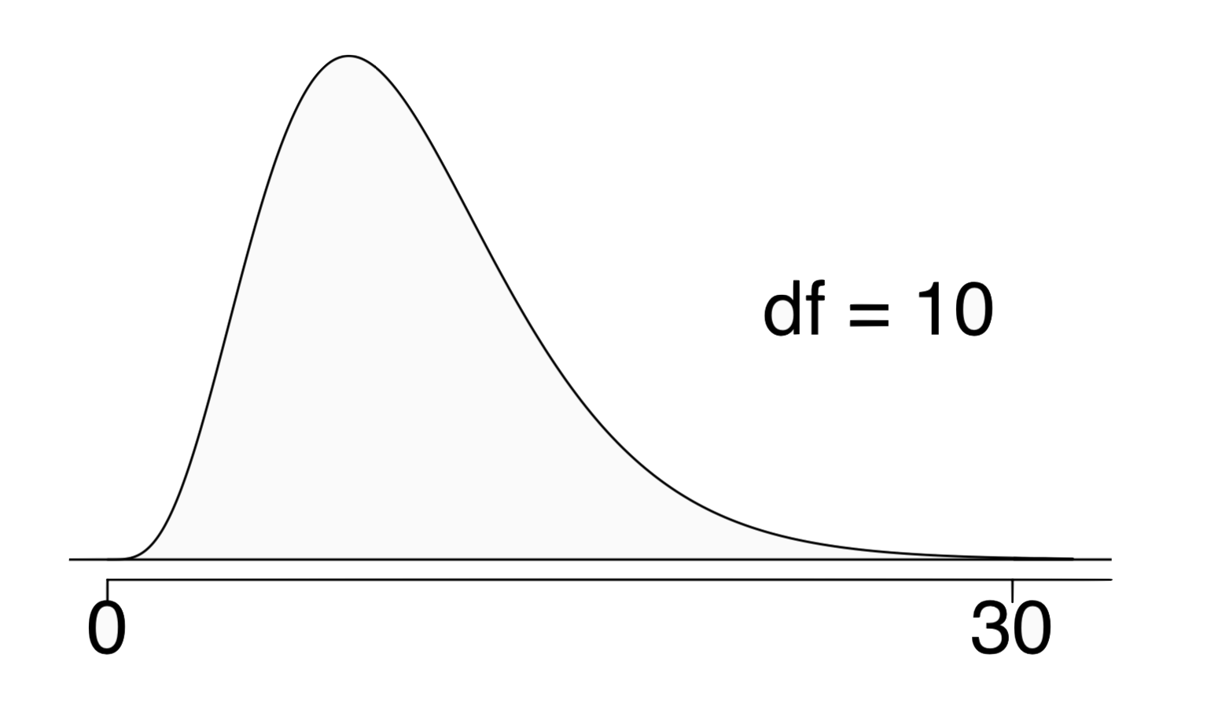
Finding areas under the chi-square curve
Estimate the shaded area above a cutoff value of 30 for the chi-square curve with df = 10.
(a) greater than 0.3
(b) between 0.005 and 0.001
(c) less than 0.001
(d) greater than 0.001
(e) cannot tell using this table

Slide 44
Finding areas under the chi-square curve
Estimate the shaded area above a cutoff value of 30 for the chi-square curve with df = 10.
(a) greater than 0.3
(b) between 0.005 and 0.001
(c) less than 0.001
(d) greater than 0.001
(e) cannot tell using this table
> pchisq(q = 30, df = 10, lower.tail = FALSE)
[1] 0.0008566412

Slide 45
Back to Labby's dice
The research question was: Do these data provide convincing evidence of an inconsistency between the observed and expected counts?

Slide 46
Back to Labby's dice
The research question was: Do these data provide convincing evidence of an inconsistency between the observed and expected counts?
The hypotheses were:
H₀: There is no inconsistency between the observed and the expected counts. The observed counts follow the same distribution as the expected counts.
H_{A}: There is an inconsistency between the observed and the expected counts. The observed counts do not follow the same distribution as the expected counts. There is a bias in which side comes up on the roll of a die.

Slide 47
Back to Labby's dice
The research question was: Do these data provide convincing evidence of an inconsistency between the observed and expected counts?
The hypotheses were:
H₀: There is no inconsistency between the observed and the expected counts. The observed counts follow the same distribution as the expected counts.
H_{A}: There is an inconsistency between the observed and the expected counts. The observed counts do not follow the same distribution as the expected counts. There is a bias in which side comes up on the roll of a die.
We had calculated a test statistic of χ² = 24.67.

Slide 48
Back to Labby's dice
The research question was: Do these data provide convincing evidence of an inconsistency between the observed and expected counts?
The hypotheses were:
H₀: There is no inconsistency between the observed and the expected counts. The observed counts follow the same distribution as the expected counts.
H_{A}: There is an inconsistency between the observed and the expected counts. The observed counts do not follow the same distribution as the expected counts. There is a bias in which side comes up on the roll of a die.
We had calculated a test statistic of χ² = 24.67.
All we need is the df and we can calculate the tail area (the p-value) and make a decision on the hypotheses.

Slide 49
Degrees of freedom for a goodness of fit test
When conducting a goodness of fit test to evaluate how well the observed data follow an expected distribution, the degrees of freedom are calculated as the number of cells (k) minus 1. df = k - 1

Slide 50
Degrees of freedom for a goodness of fit test
When conducting a goodness of fit test to evaluate how well the observed data follow an expected distribution, the degrees of freedom are calculated as the number of cells (k) minus 1. df = k - 1
For dice outcomes, k = 6, therefore df = 6 - 1 = 5

Slide 51
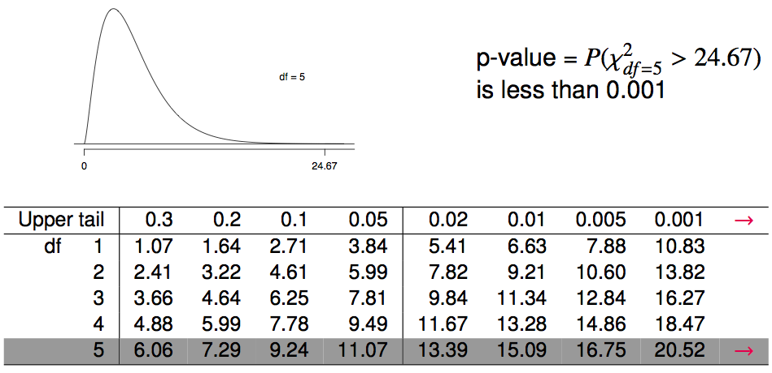
Finding a p-value for a chi-square test
The p-value for a chi-square test is defined as the tail area above the calculated test statistic.

Slide 52
Conclusion of the hypothesis test
We calculated a p-value less than 0.001. At 5% significance level, what is the conclusion of the hypothesis test?
Reject H₀, the data provide convincing evidence that the dice are fair.
Reject H₀, the data provide convincing evidence that the dice are biased.
Fail to reject H₀, the data provide convincing evidence that the dice are fair.
Fail to reject H₀, the data provide convincing evidence that the dice are biased.

Slide 53
Conclusion of the hypothesis test
We calculated a p-value less than 0.001. At 5% significance level, what is the conclusion of the hypothesis test?
Reject H₀, the data provide convincing evidence that the dice are fair.
Reject H₀, the data provide convincing evidence that the dice are biased.
Fail to reject H₀, the data provide convincing evidence that the dice are fair.
Fail to reject H₀, the data provide convincing evidence that the dice are biased.

Slide 54
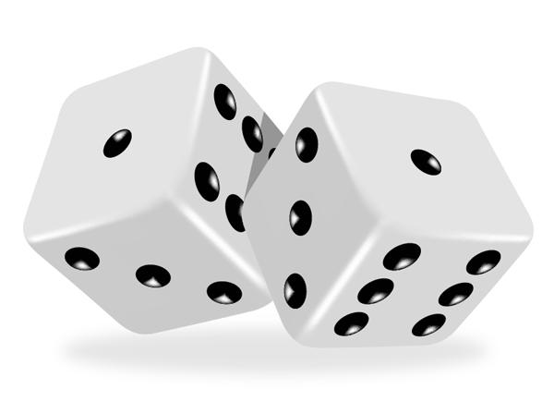
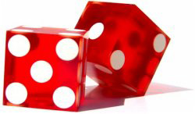
Turns out...
The 1-6 axis is consistently shorter than the other two (2-5 and 3-4), thereby supporting the hypothesis that the faces with one and six pips are larger than the other faces.
Pearson's claim that 5s and 6s appear more often due to the carved-out pips is not supported by these data.
Dice used in casinos have flush faces, where the pips are filled in with a plastic of the same density as the surrounding material and are precisely balanced.

Slide 55
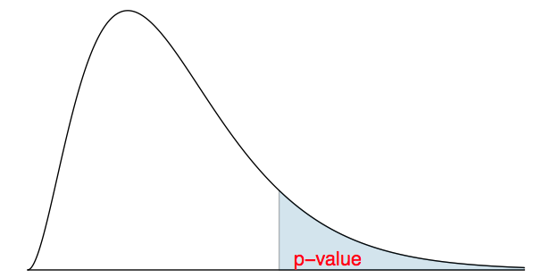
Recap: p-value for a chi-square test
The p-value for a chi-square test is defined as the tail area above the calculated test statistic.
This is because the test statistic is always positive, and a higher test statistic means a stronger deviation from the null hypothesis.

Slide 56
Conditions for the chi-square test
Independence: Each case that contributes a count to the table must be independent of all the other cases in the table.

Slide 57
Conditions for the chi-square test
Independence: Each case that contributes a count to the table must be independent of all the other cases in the table.
Sample size: Each particular scenario (i.e. cell) must have at least 5 expected cases.

Slide 58
Conditions for the chi-square test
Independence: Each case that contributes a count to the table must be independent of all the other cases in the table.
Sample size: Each particular scenario (i.e. cell) must have at least 5 expected cases.
df > 1: Degrees of freedom must be greater than 1.

Slide 59
Conditions for the chi-square test
Independence: Each case that contributes a count to the table must be independent of all the other cases in the table.
Sample size: Each particular scenario (i.e. cell) must have at least 5 expected cases.
df > 1: Degrees of freedom must be greater than 1.
Failing to check conditions may unintentionally affect the test's error rates.

Slide 60
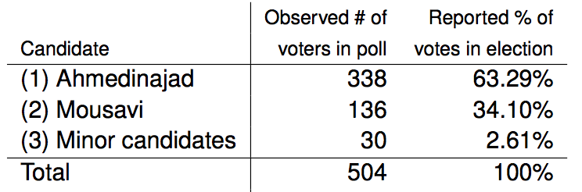
2009 Iran Election
There was lots of talk of election fraud in the 2009 Iran election. We'll compare the data from a poll conducted before the election (observed data) to the reported votes in the election to see if the two follow the same distribution.

Slide 61
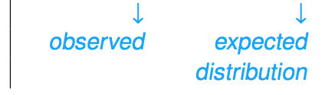
2009 Iran Election
There was lots of talk of election fraud in the 2009 Iran election. We'll compare the data from a poll conducted before the election (observed data) to the reported votes in the election to see if the two follow the same distribution.

Slide 62
Hypotheses
What are the hypotheses for testing if the distributions of reported and polled votes are different?

Slide 63
Hypotheses
What are the hypotheses for testing if the distributions of reported and polled votes are different?
H₀: The observed counts from the poll follow the same distribution as the reported votes.
H_{A}: The observed counts from the poll do not follow the same distribution as the reported votes.

Slide 64
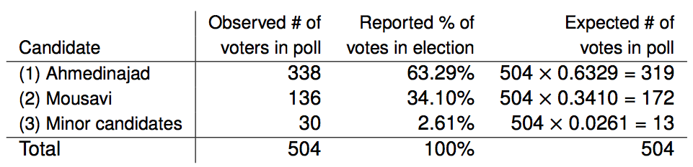
Calculation of the test statistic

Slide 65

Calculation of the test statistic

Slide 66

Calculation of the test statistic

Slide 67

Calculation of the test statistic

Slide 68

Calculation of the test statistic

Slide 69
Conclusion
Based on these calculations what is the conclusion of the hypothesis test?
p-value is low, H₀ is rejected. The observed counts from the poll do not follow the same distribution as the reported votes.
p-value is high, H₀ is not rejected. The observed counts from the poll follow the same distribution as the reported votes.
p-value is low, H₀ is rejected. The observed counts from the poll follow the same distribution as the reported votes
p-value is low, H₀ is not rejected. The observed counts from the poll do not follow the same distribution as the reported votes.

Slide 70
Conclusion
Based on these calculations what is the conclusion of the hypothesis test?
p-value is low, H₀ is rejected. The observed counts from the poll do not follow the same distribution as the reported votes.
p-value is high, H₀ is not rejected. The observed counts from the poll follow the same distribution as the reported votes.
p-value is low, H₀ is rejected. The observed counts from the poll follow the same distribution as the reported votes
p-value is low, H₀ is not rejected. The observed counts from the poll do not follow the same distribution as the reported votes.

Slide 71
Find more resources at openintro.org/os, including
Slides
Videos
Statistical Software Labs
Discussion Forums (free support for students and teachers)
Learning Objectives
Teachers only content is also available for Verified Teachers, including
Exercise solutions
Sample exams
Ability to request a free desk copy for a course
Statistics Teachers email group
Questions? Contact us.

Slide 72
Extra Slides from the OS3 section on testing for goodness of fit

Slide 73
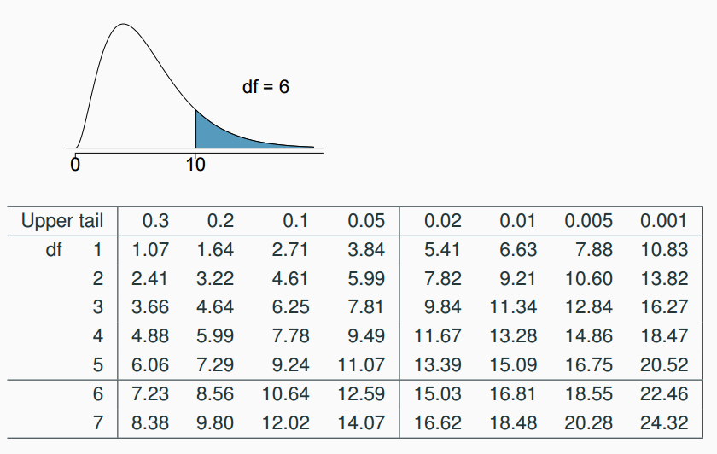
Finding areas under the chi-square curve
Estimate the shaded area under the chi-square curve with df = 6.

Slide 74
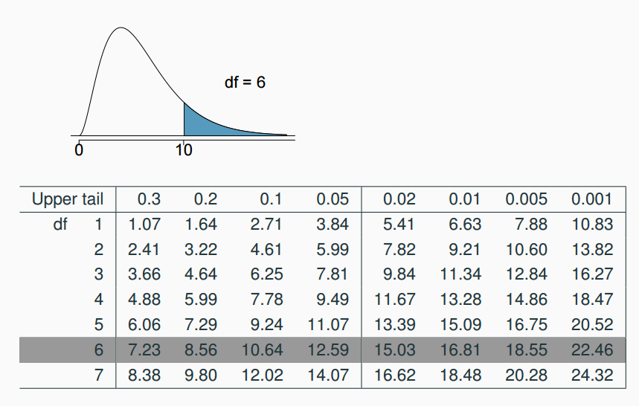
Finding areas under the chi-square curve (cont.)
Estimate the shaded area under the chi-square curve with df = 6.

Slide 75
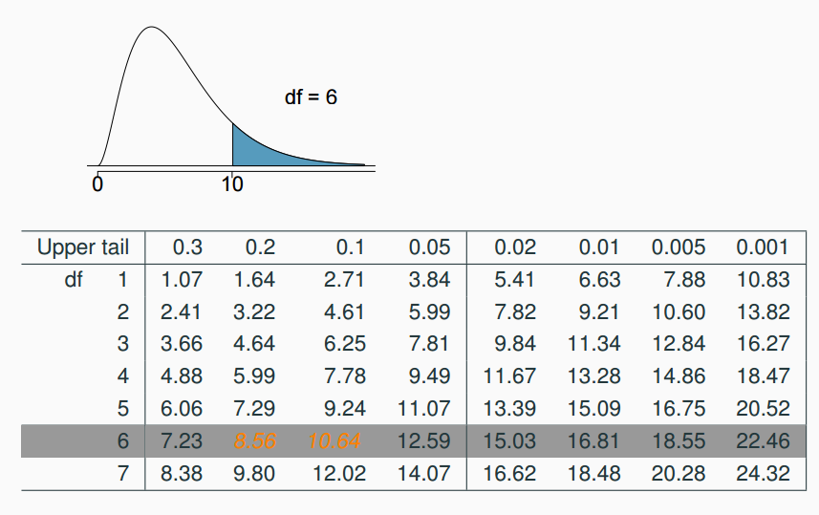
Finding areas under the chi-square curve (cont.)
Estimate the shaded area under the chi-square curve with df = 6.

Slide 76
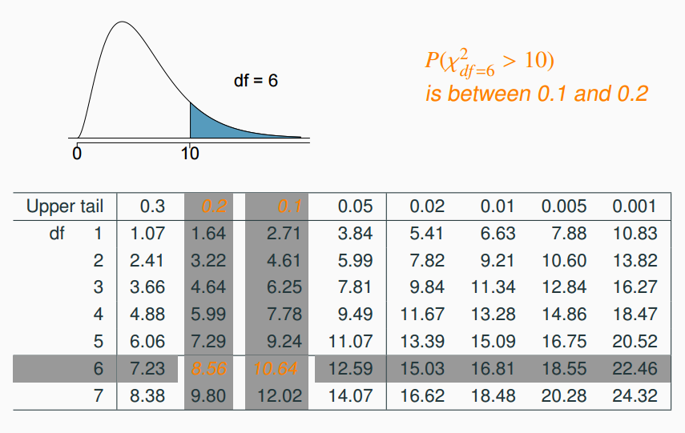
Finding areas under the chi-square curve (cont.)
Estimate the shaded area under the chi-square curve with df = 6.

Slide 77
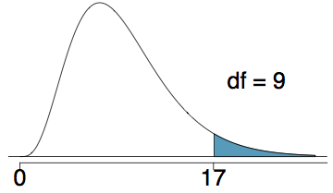
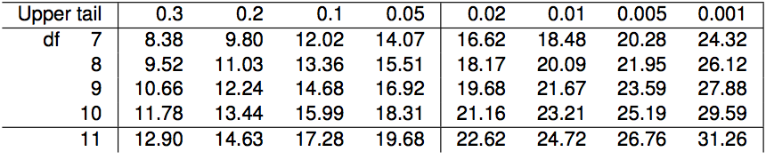
Finding areas under the chi-square curve (cont.)
Estimate the shaded area (above 17) under the χ² curve with df = 9.
between 0.01 and 0.02
0.02
between 0.02 and 0.05
0.05
between 0.05 and 0.10

Slide 78
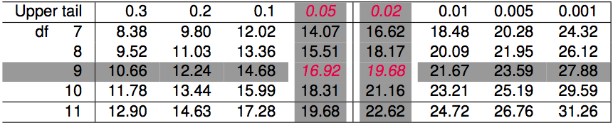
Finding areas under the chi-square curve (cont.)
Estimate the shaded area (above 17) under the χ² curve with df = 9.
between 0.01 and 0.02
0.02
between 0.02 and 0.05
0.05
between 0.05 and 0.10

Slide 79
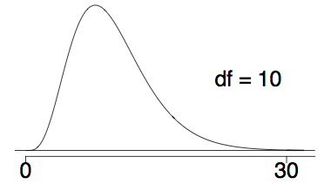
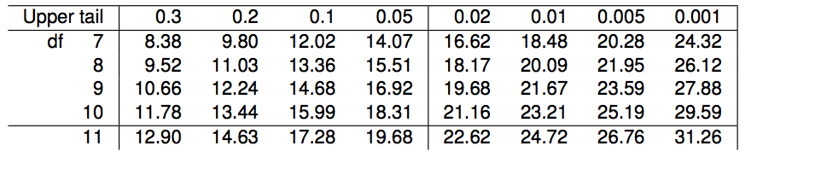
Finding areas under the chi-square curve (one more)
Estimate the shaded area (above 30) under the χ² curve with df = 10.
between 0.005 and 0.001
less than 0.001
greater than 0.001
greater than 0.3
cannot tell using this table

Slide 80
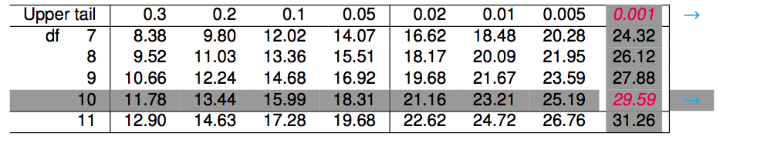
Finding areas under the chi-square curve (one more)
Estimate the shaded area (above 30) under the χ² curve with df = 10.
greater than 0.3
between 0.005 and 0.001
less than 0.001
greater than 0.001
cannot tell using this table

Slide 81
Finding the tail areas using computation
While probability tables are very helpful in understanding how probability distributions work, and provide quick reference when computational resources are not available, they are somewhat archaic.

Slide 82
Finding the tail areas using computation
While probability tables are very helpful in understanding how probability distributions work, and provide quick reference when computational resources are not available, they are somewhat archaic.
Using R: pchisq(q = 30, df = 10, lower.tail = FALSE) # 0.0008566412

Slide 83
Finding the tail areas using computation
While probability tables are very helpful in understanding how probability distributions work, and provide quick reference when computational resources are not available, they are somewhat archaic.
Using R: pchisq(q = 30, df = 10, lower.tail = FALSE) # 0.0008566412
Using a web applet: http://bitly.com/dist_calc

Slide 84
Finding a p-value for a chi-square test
The p-value for a chi-square test is defined as the tail area above the calculated test statistic.

